Slide 1
Digital Image Processing
Lecture 7:
Image Enhancement in the Frequency Domain
Dr. Hossam Mahmoud Moftah
Assistant professor – Faculty of computers and information –
Beni Suef University

Slide 2
Background
Any function that periodically repeats itself can be expressed as the sum of sines and/or cosines of different frequencies, each multiplied by a different coefficient (Fourier series).
Even functions that are not periodic (but whose area under the curve is finite) can be expressed as the integral of sines and/or cosines multiplied by a weighting function (Fourier transform).

Slide 3
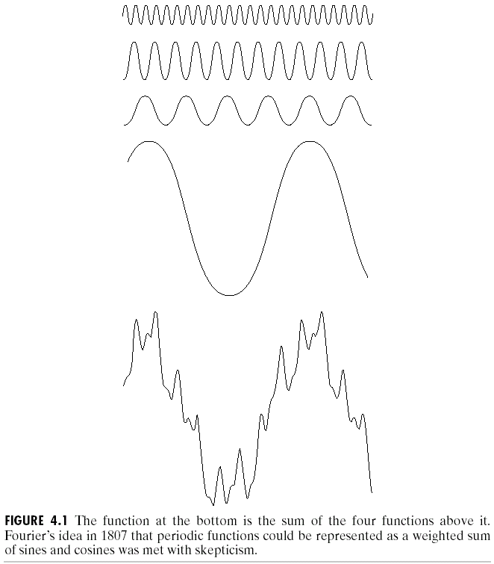
Background
The frequency domain refers to the plane of the two dimensional discrete Fourier transform of an image.
The purpose of the Fourier transform is to represent a signal as a linear combination of sinusoidal signals of various frequencies.

Slide 4
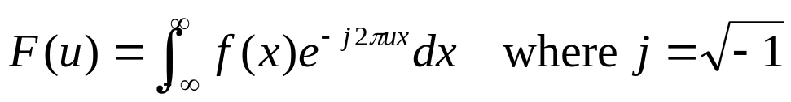

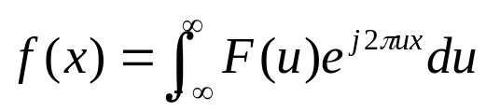
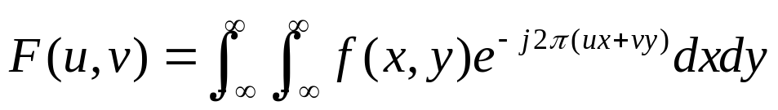
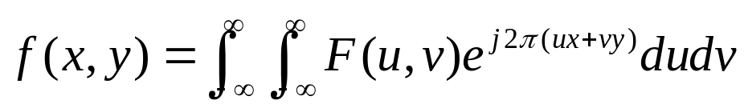
Introduction to the Fourier Transform
and the Frequency Domain
The one-dimensional Fourier transform and its inverse
  Fourier transform (continuous case)
  Inverse Fourier transform:
The two-dimensional Fourier transform and its inverse
  Fourier transform (continuous case)
  Inverse Fourier transform:

Slide 5
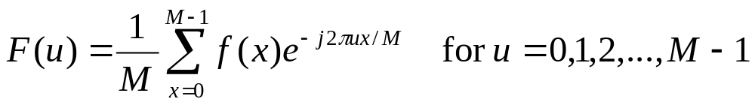
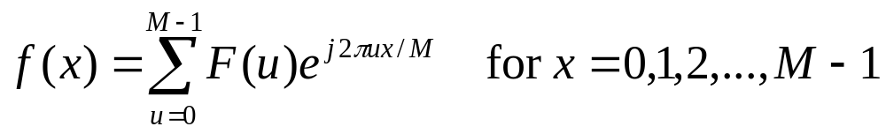
Introduction to the Fourier Transform and the Frequency Domain
The one-dimensional Fourier transform and its inverse
  Fourier transform (discrete case) DTC
  Inverse Fourier transform:

Slide 6

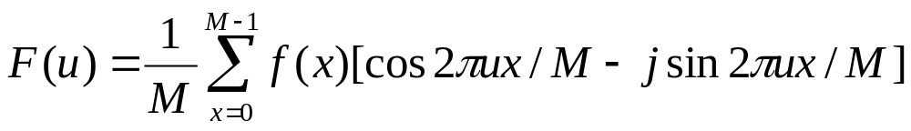

Introduction to the Fourier Transform and the Frequency Domain
Since and the fact
  then discrete Fourier transform can be redefined
  Frequency (time) domain: the domain (values of u) over which the values of F(u) range; because u determines the frequency of the components of the transform.
  Frequency (time) component: each of the M terms of F(u).

Slide 7
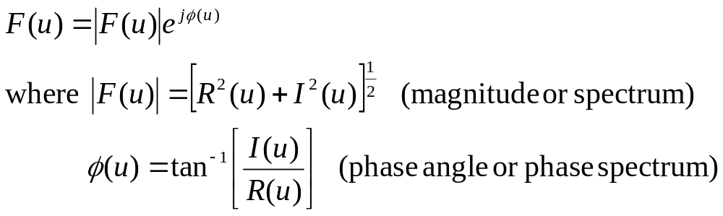
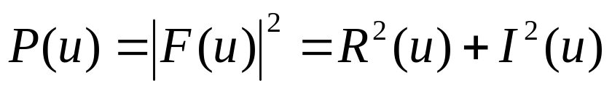
Introduction to the Fourier Transform and the Frequency Domain
F(u) can be expressed in polar coordinates:
  R(u): the real part of F(u)
  I(u): the imaginary part of F(u)
Power spectrum:

Slide 8
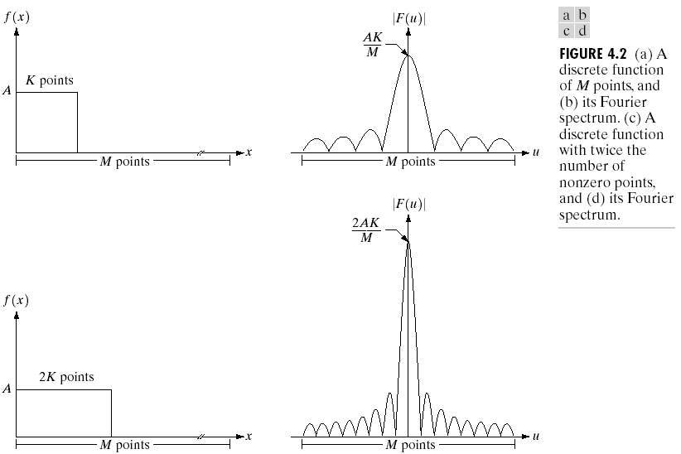
The One-Dimensional Fourier Transform Example

Slide 9


The One-Dimensional Fourier Transform Some Examples
The transform of a constant function is a DC value only.
The transform of a delta function is a constant.

Slide 10


The One-Dimensional Fourier Transform Some Examples
The transform of an infinite train of delta functions spaced by T is an infinite train of delta functions spaced by 1/T.
The transform of a cosine function is a positive delta at the appropriate positive and negative frequency.

Slide 11


The One-Dimensional Fourier Transform Some Examples
The transform of a sin function is a negative complex delta function at the appropriate positive frequency and a negative complex delta at the appropriate negative frequency.
The transform of a square pulse is a sinc function.

Slide 12
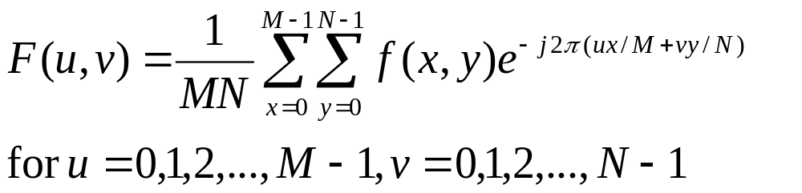
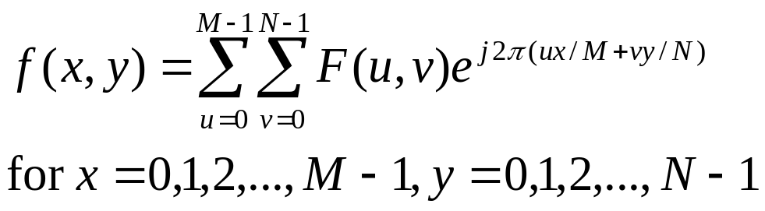
Introduction to the Fourier Transform and the Frequency Domain
The two-dimensional Fourier transform and its inverse
  Fourier transform (discrete case) DTC
  Inverse Fourier transform:
    u, v : the transform or frequency variables
    x, y : the spatial or image variables

Slide 13
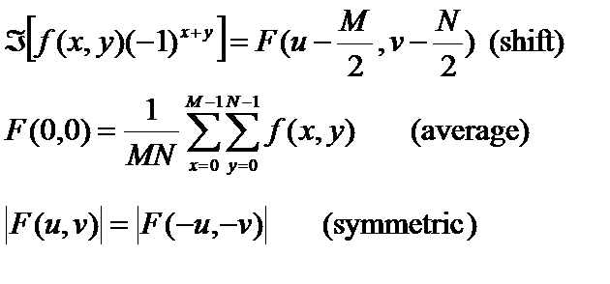
Introduction to the Fourier Transform and the Frequency Domain
Some properties of Fourier transform:

Slide 14

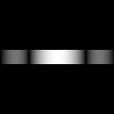
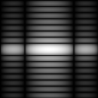
The Two-Dimensional DFT and Its Inverse
The 2D DFT F(u,v) can be obtained by
taking the 1D DFT of every row of image f(x,y), F(u,y),
taking the 1D DFT of every column of F(u,y)
(a)f(x,y) (b)F(u,y) (c)F(u,v)

Slide 15
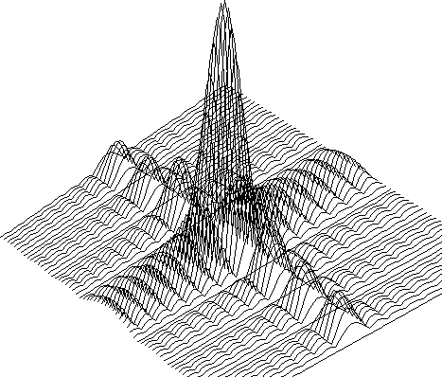
The Two-Dimensional DFT and Its Inverse

Slide 16

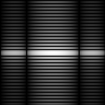

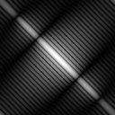
The Property of Two-Dimensional DFT Rotation
DFT
DFT

Slide 17

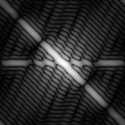
The Property of Two-Dimensional DFT Linear Combination
A
DFT
B
DFT
0.25 * A
+ 0.75 * B
DFT

Slide 18


The Property of Two-Dimensional DFT Expansion
A
DFT
B
DFT
Expanding the original image by a factor of n (n=2), filling the empty new values with zeros, results in the same DFT.

Slide 19

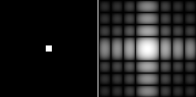
Two-Dimensional DFT with Different Functions
Sine wave
Its DFT
Rectangle
Its DFT

Slide 20

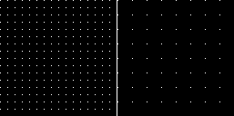
Two-Dimensional DFT with Different Functions
2D Gaussian
function
Its DFT
Impulses
Its DFT

Slide 21
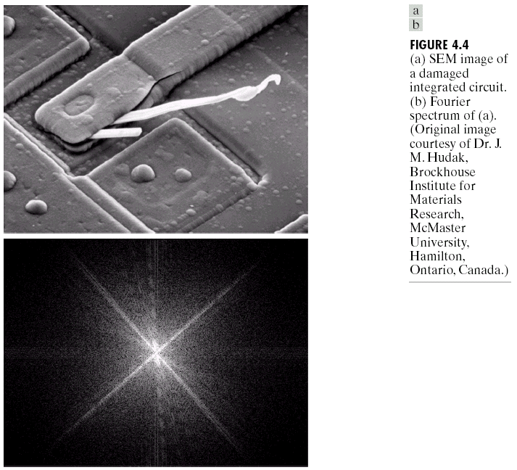
Filtering in the Frequency Domain

Slide 22
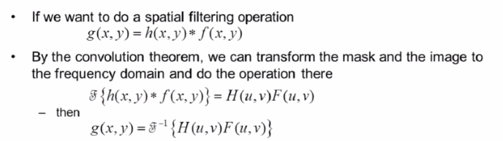
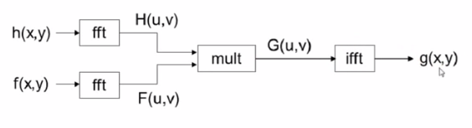
Filtering in the Frequency Domain

Slide 23
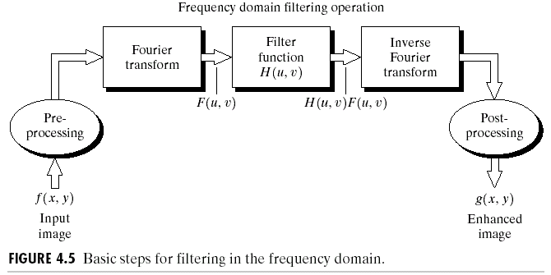
Basics of Filtering in the Frequency Domain

Slide 24
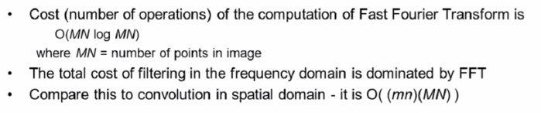

Advantages of Filtering in the Frequency Domain

Slide 25
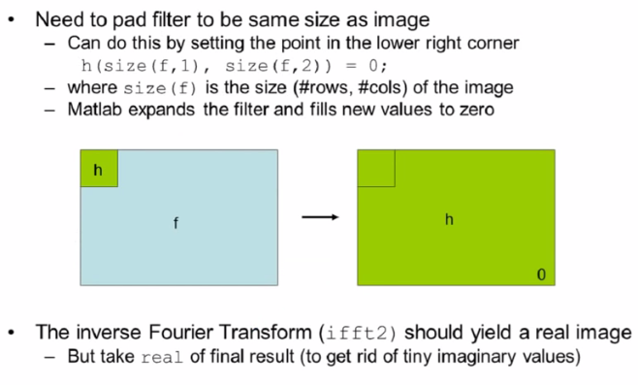
Fourier Transform in Matlab

Slide 26
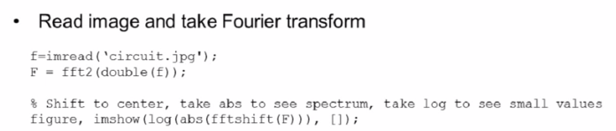
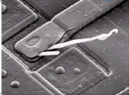
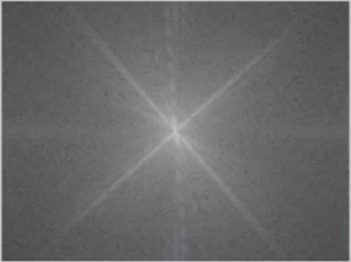
Fourier Transform in Matlab

Slide 27
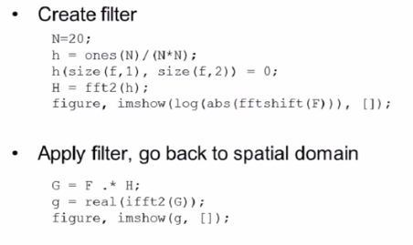

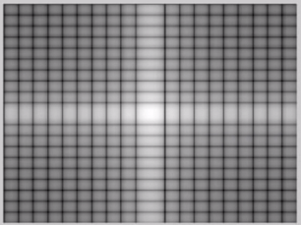
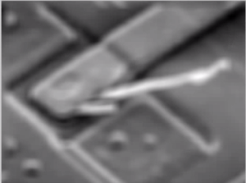
Fourier Transform in Matlab

Slide 28
The End

